Slide 1
Calculator Review The Exponential Function
College Algebra

Slide 2
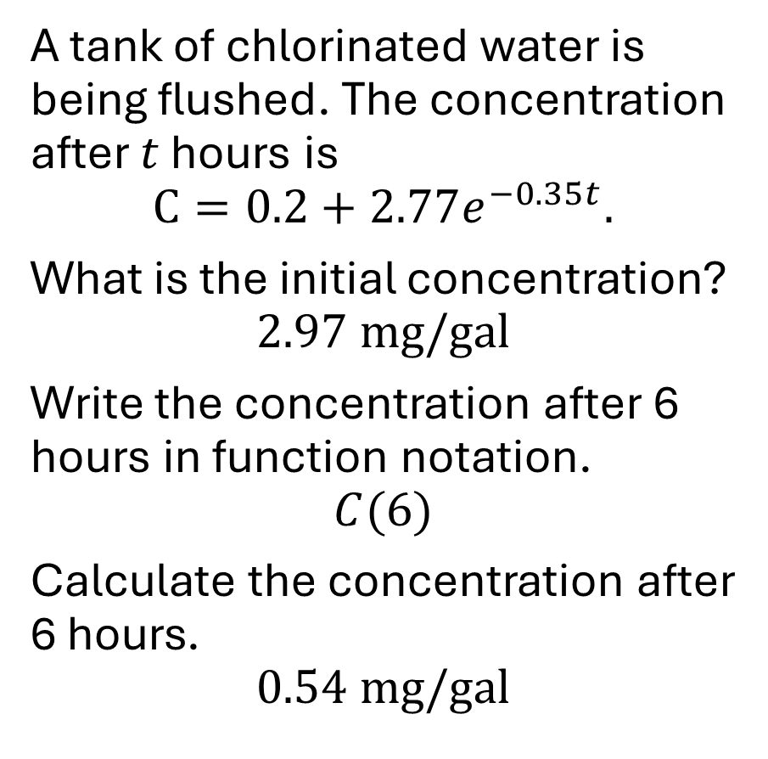
Example
A tank of chlorinated water is being flushed. The concentration after $t$ hours is $$C=0.2+2.77e^{−0.35t}.$$
What is the initial concentration?
$$2.97 \text{mg}/\text{gal}$$
Write the concentration after 6 hours in function notation.
$$C(6)$$
Calculate the concentration after 6 hours.
$$0.54 \text{mg}/\text{gal}$$

